Slide 1
Akaar- Working Explained

Slide 2
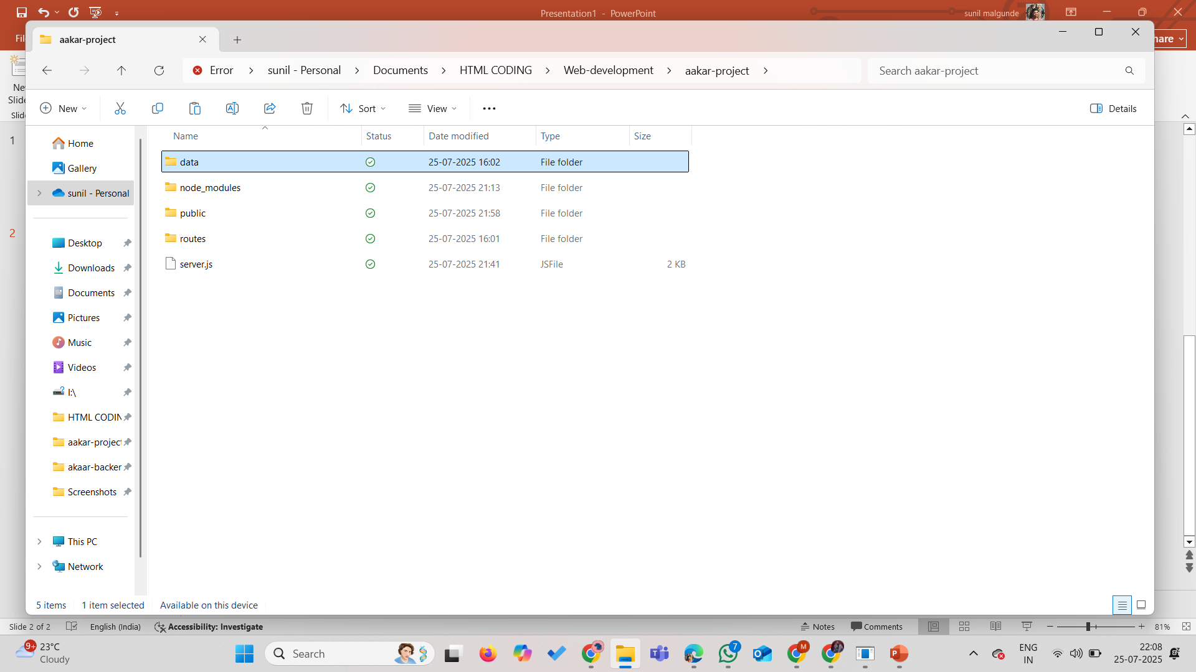
Create a folder for project, add server.js in it. Create folders data,routes and public.

Slide 3
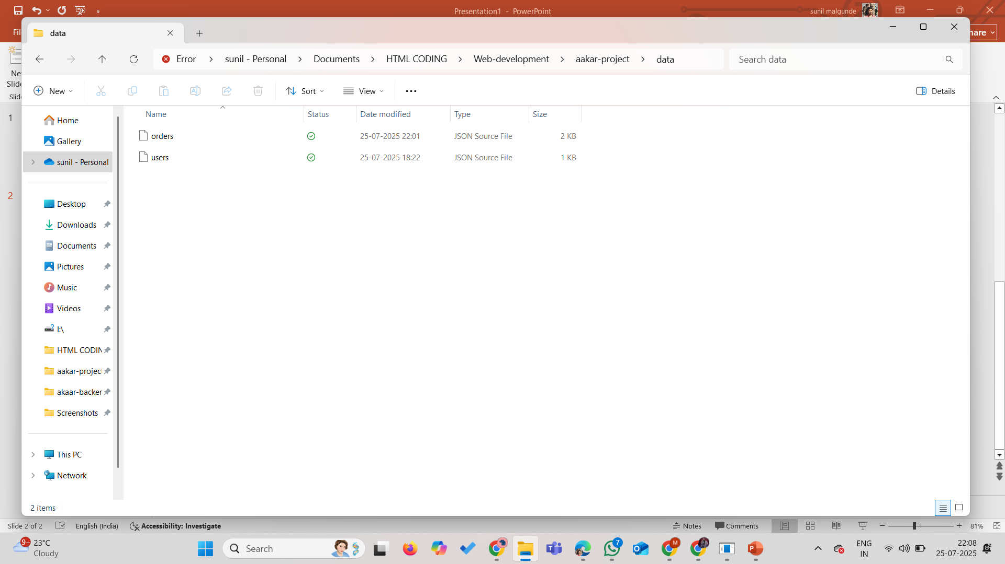
Inside data folder add orders.json and users.json

Slide 4
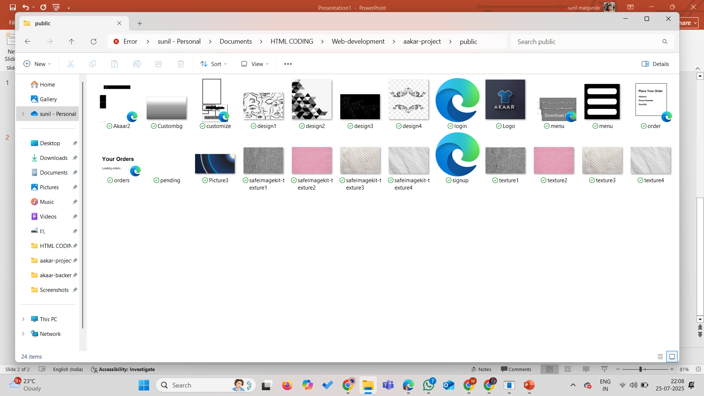
Add all the web-pages related stuff inside the public folder.

Slide 5

Add auth.js and order.js inside the routes folder.

Slide 6
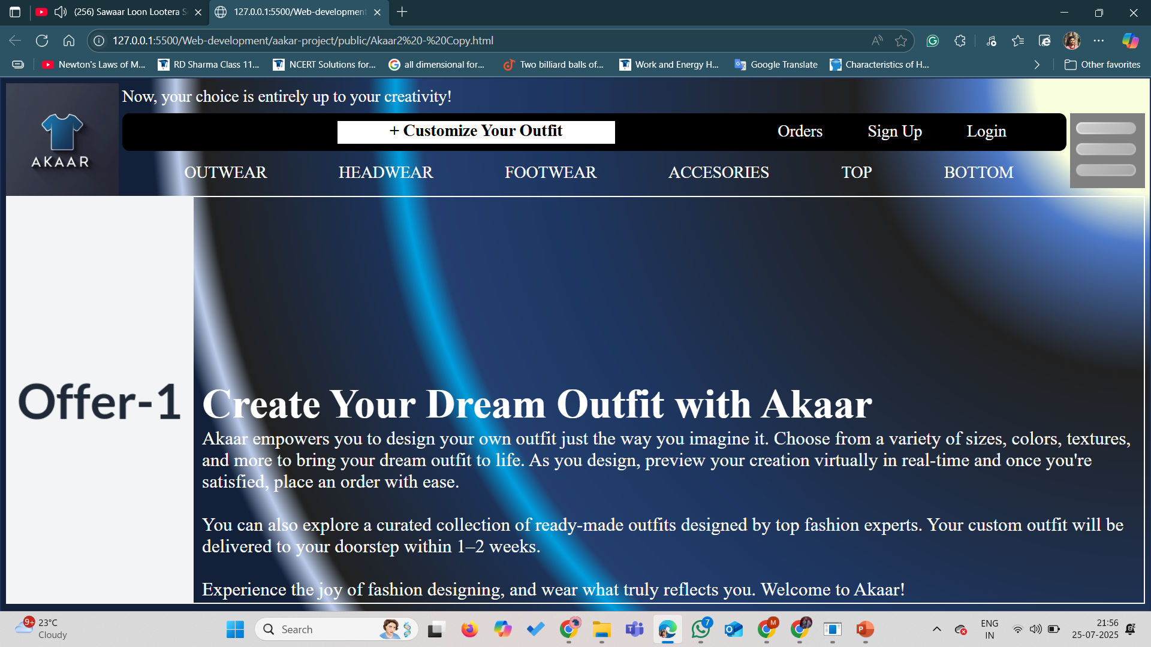
This page will appear after running “node server.js” on terminal/VS code.

Slide 8
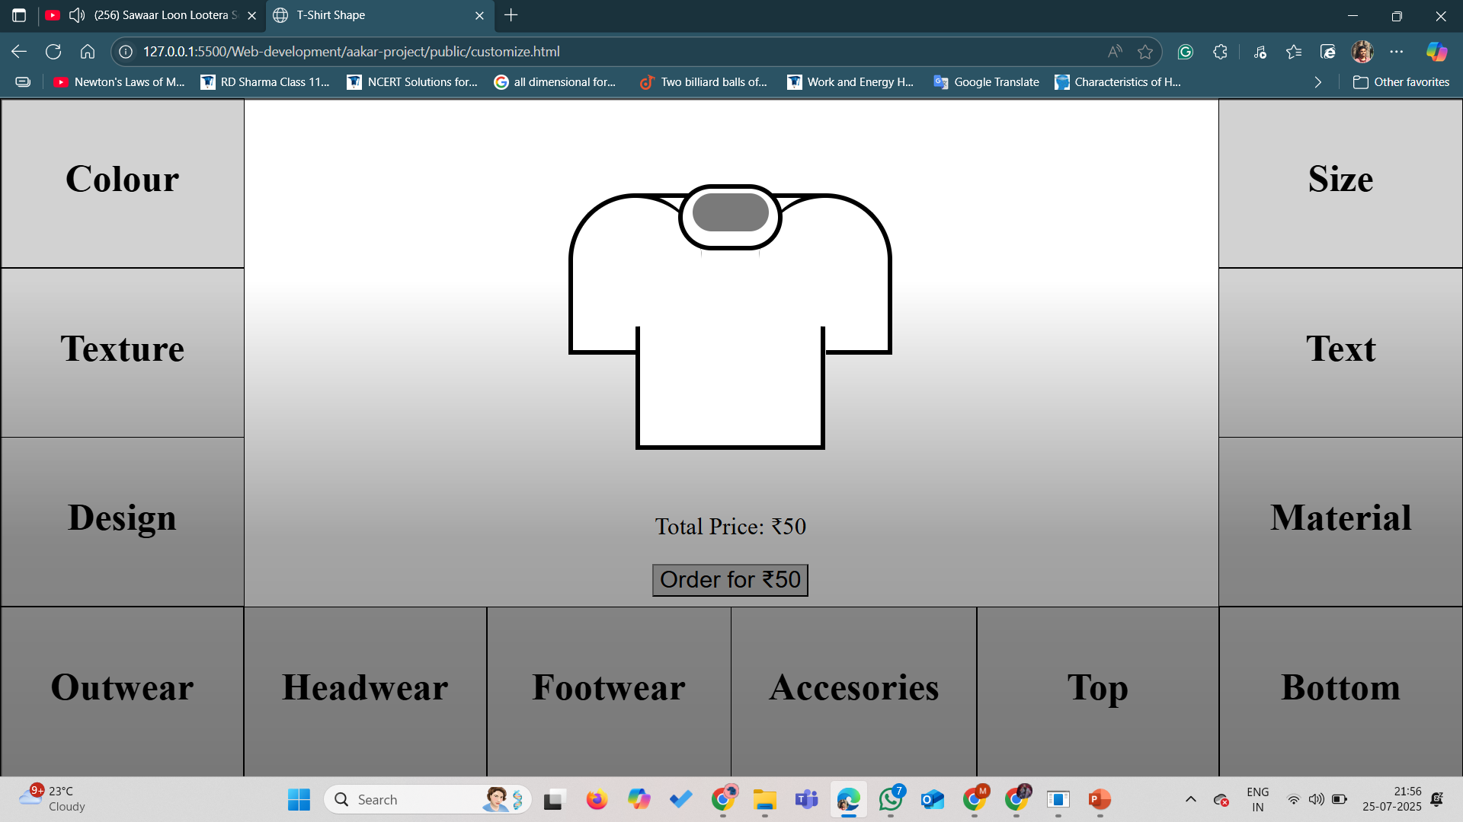

Slide 9
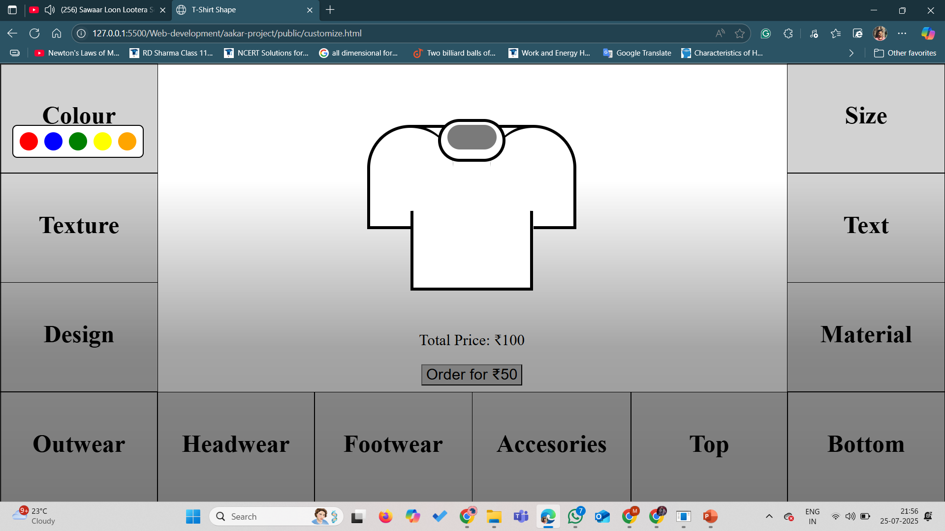

Slide 10
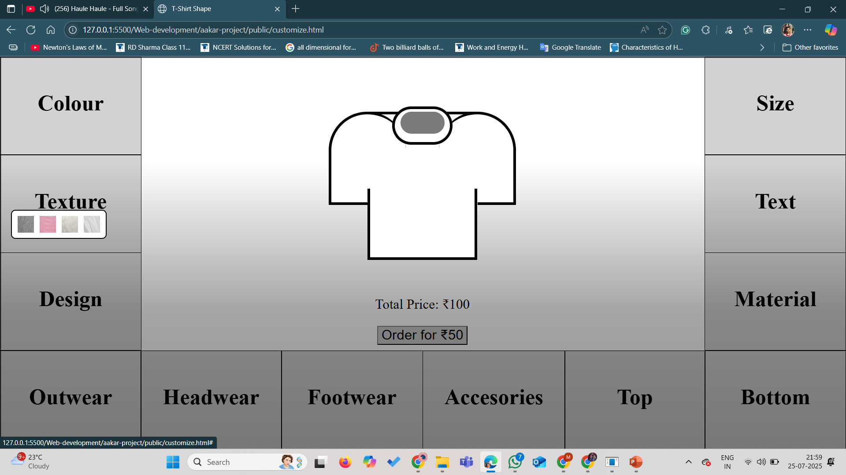

Slide 11
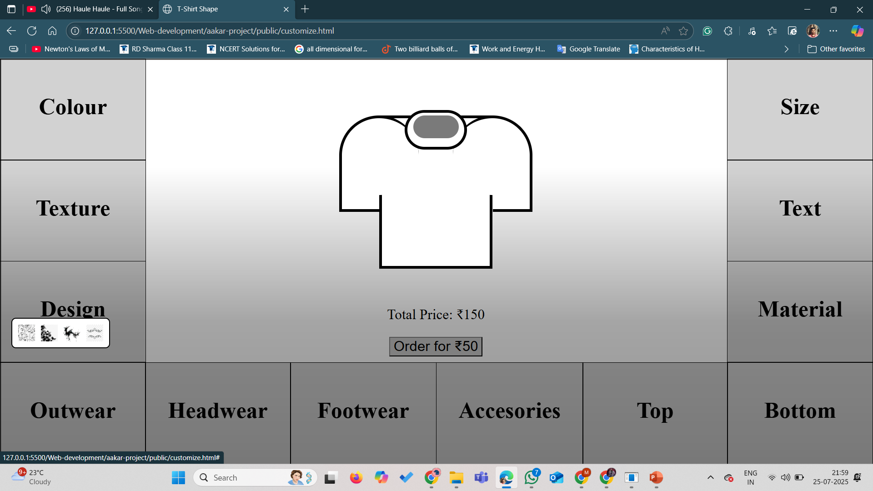

Slide 12
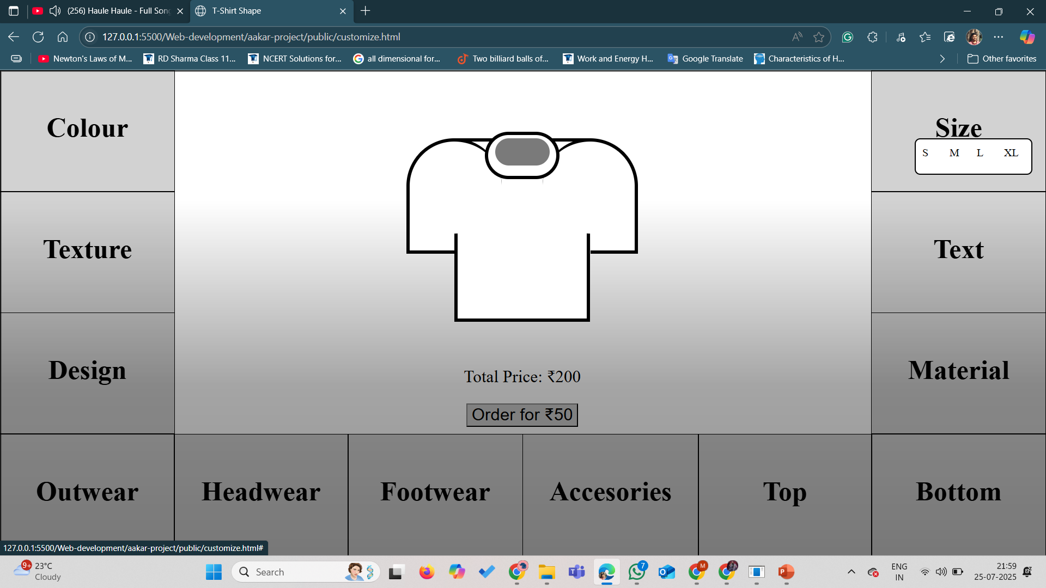

Slide 13
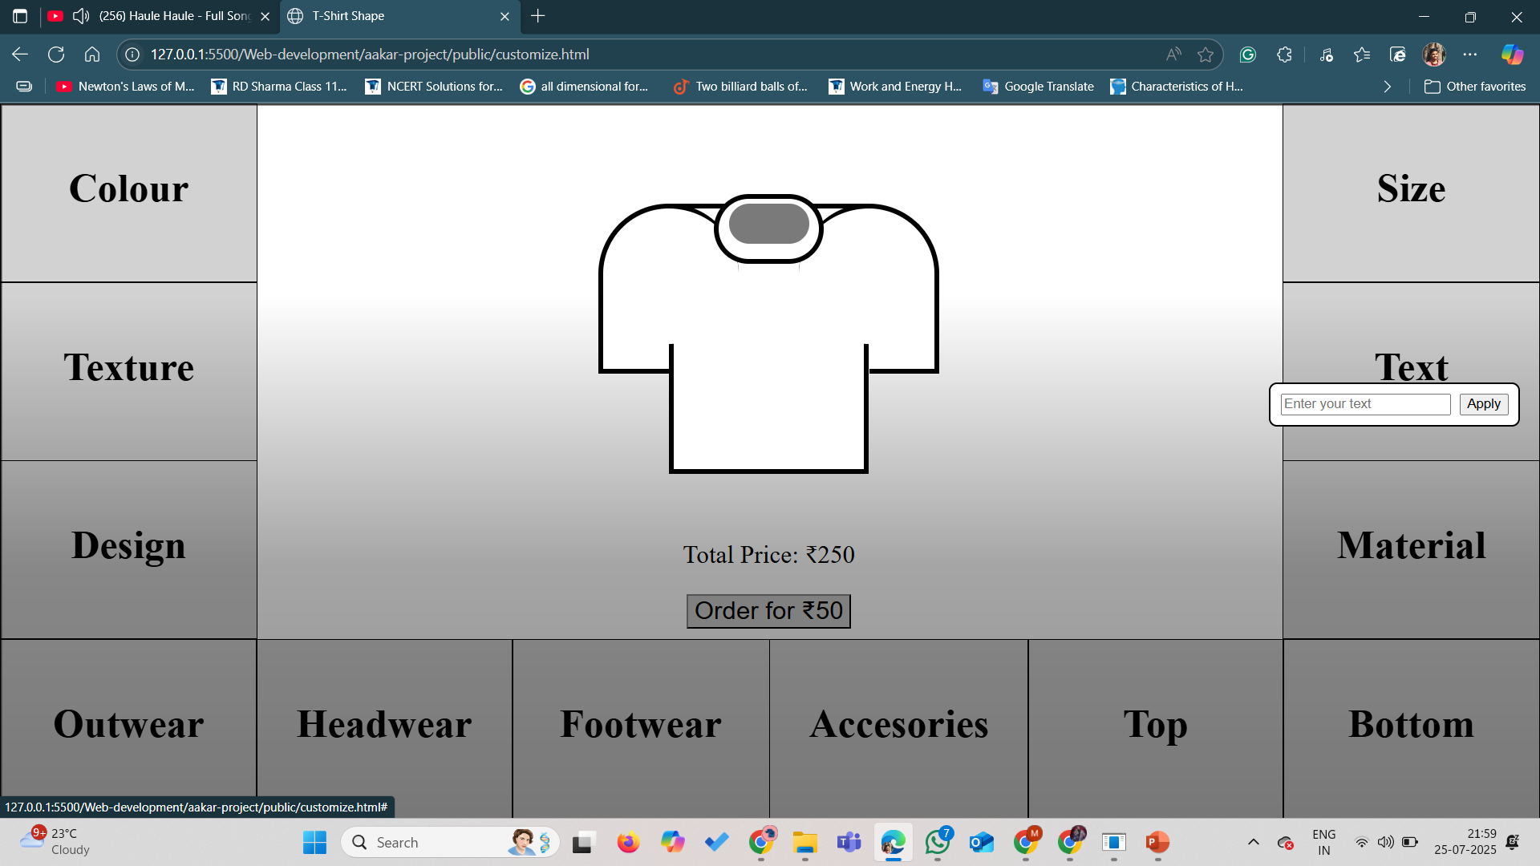

Slide 14
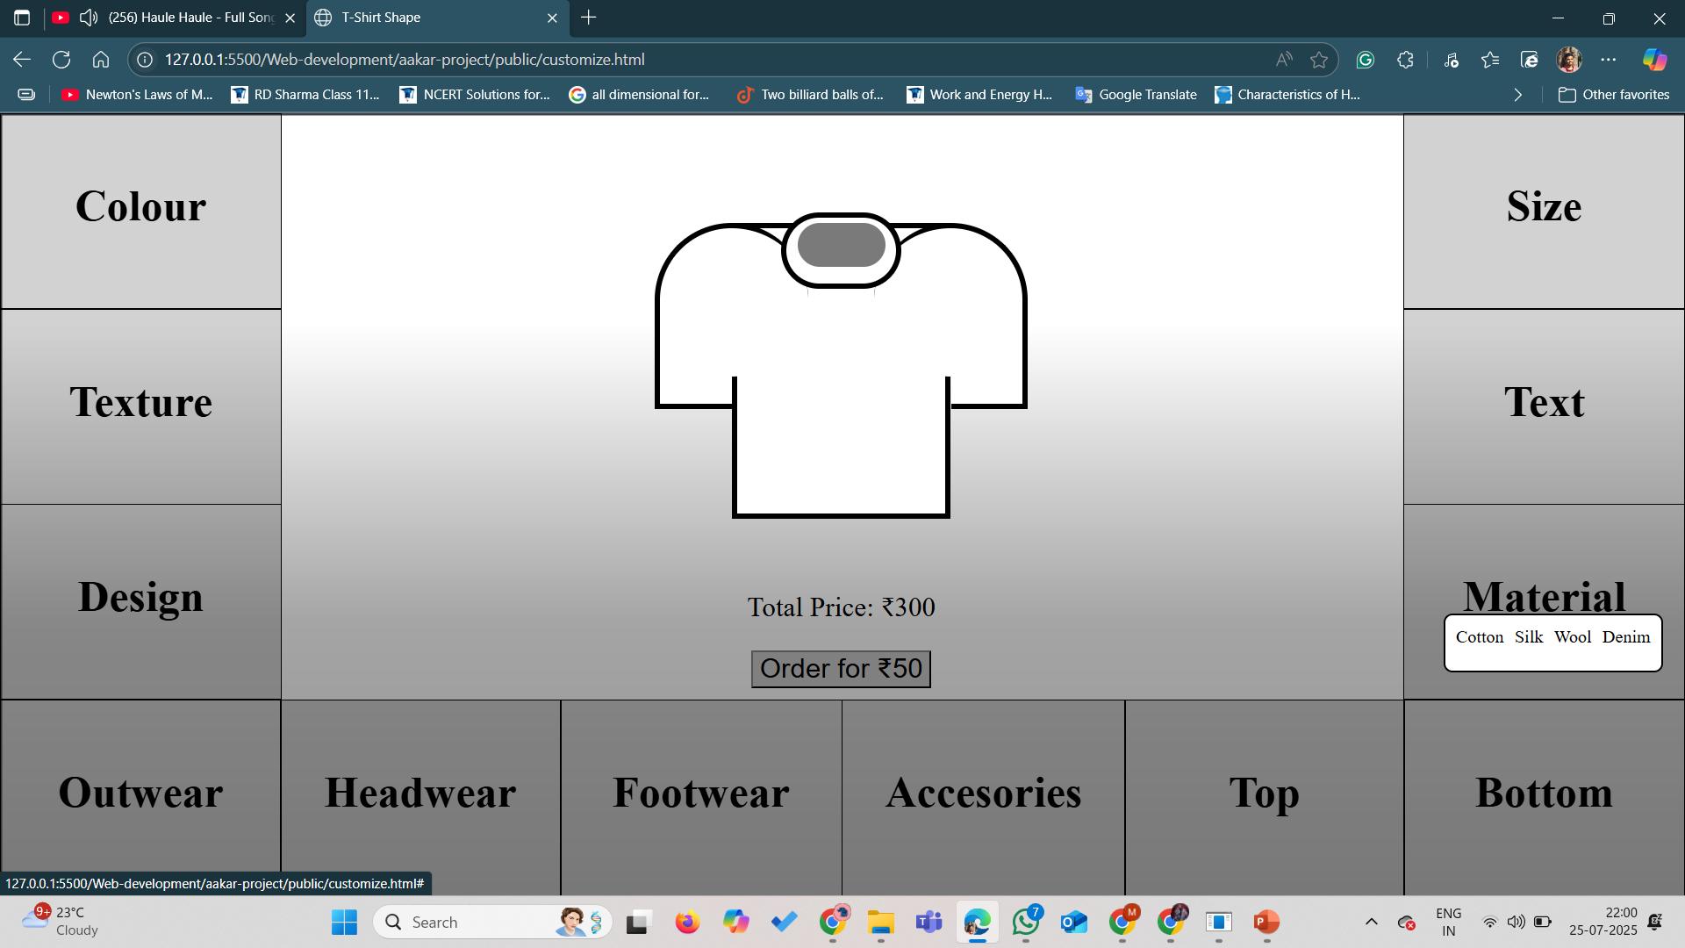

Slide 15
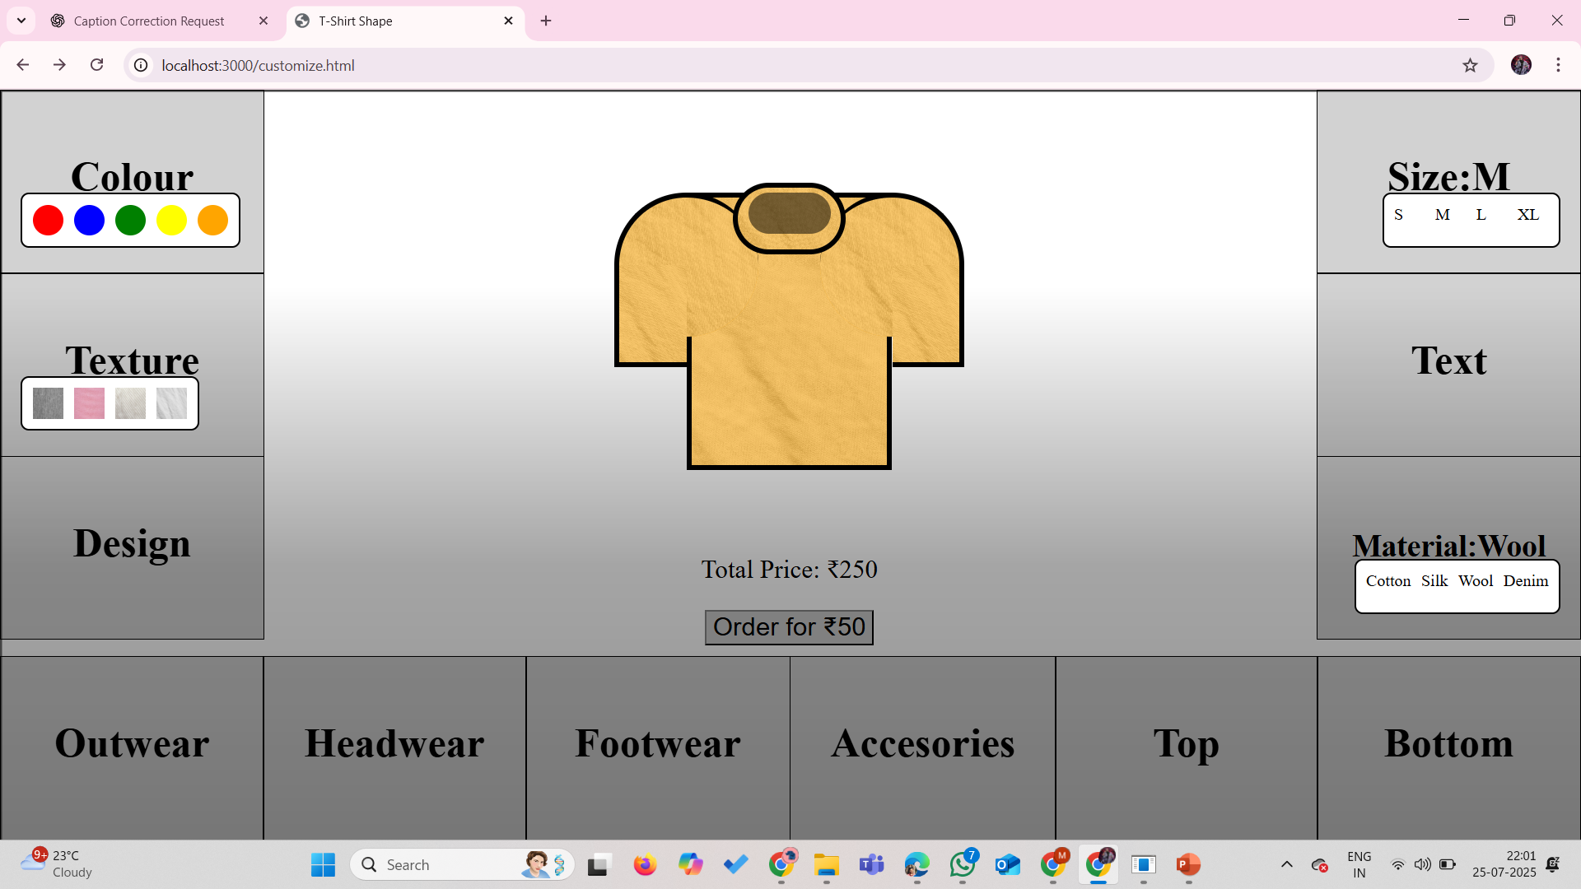

Slide 16
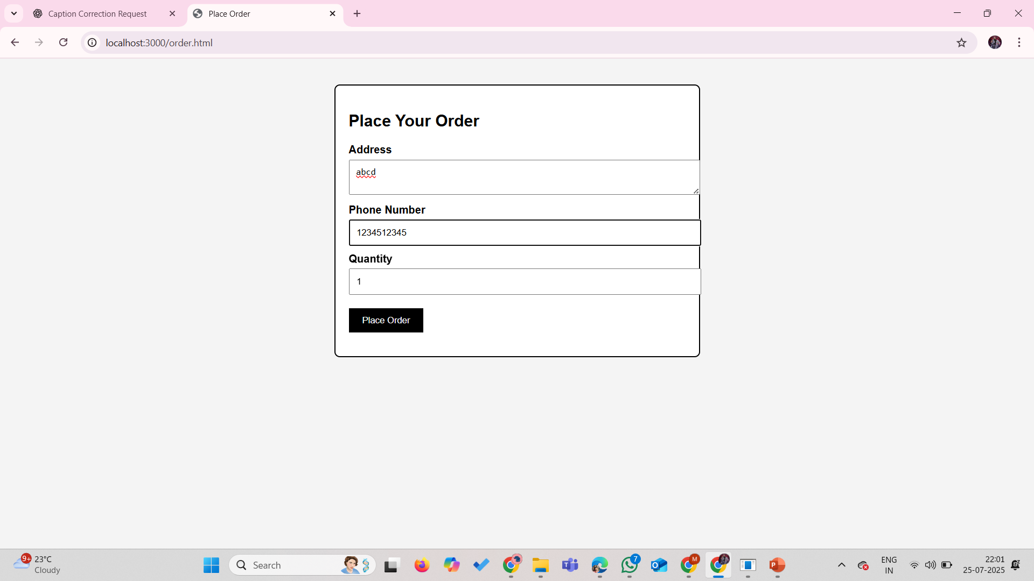
Fill the necessary info

Slide 17
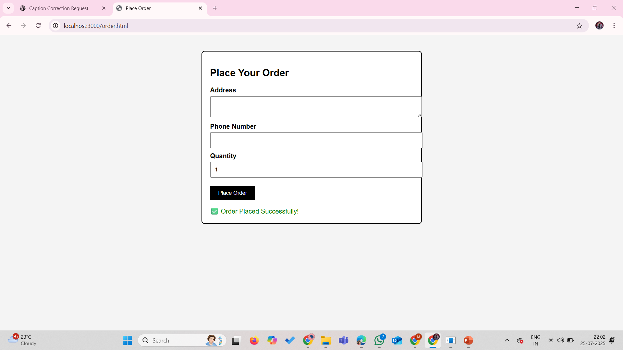

Slide 19
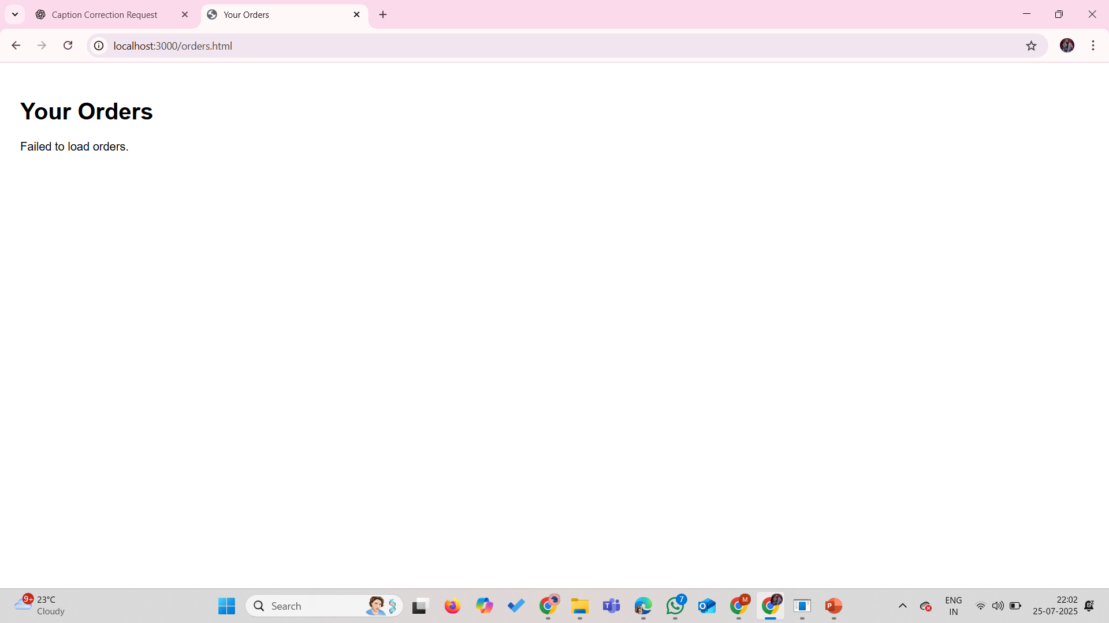

Slide 20
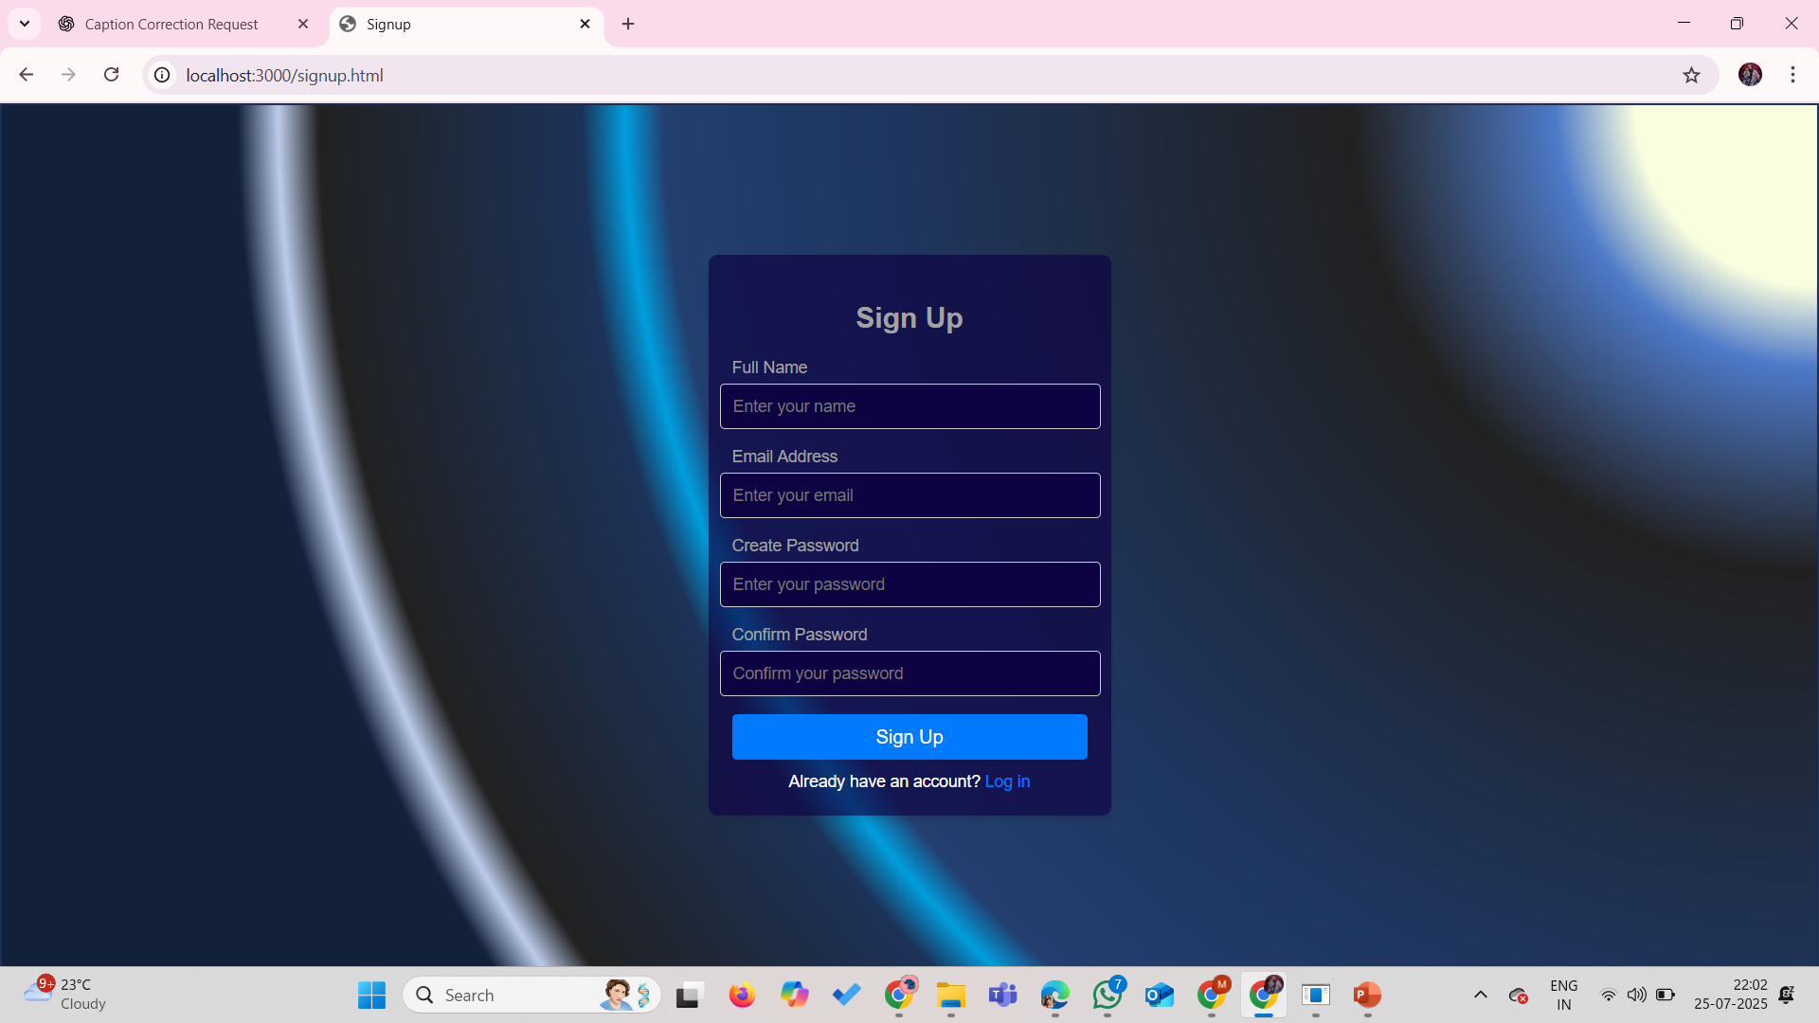

Slide 21
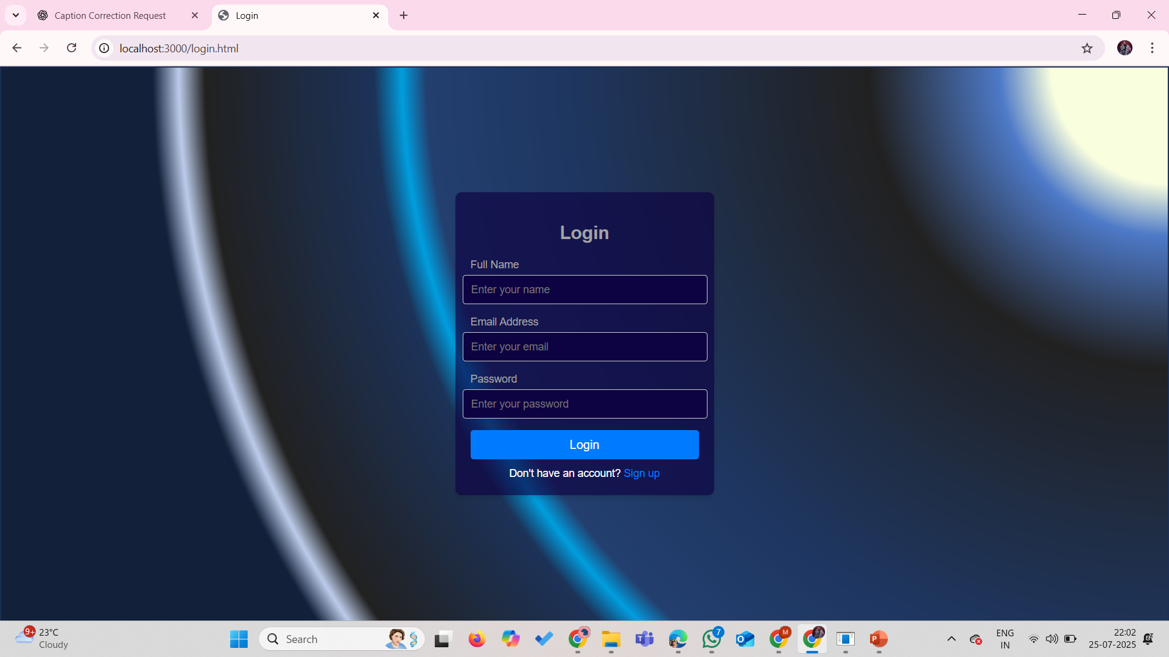

Slide 23
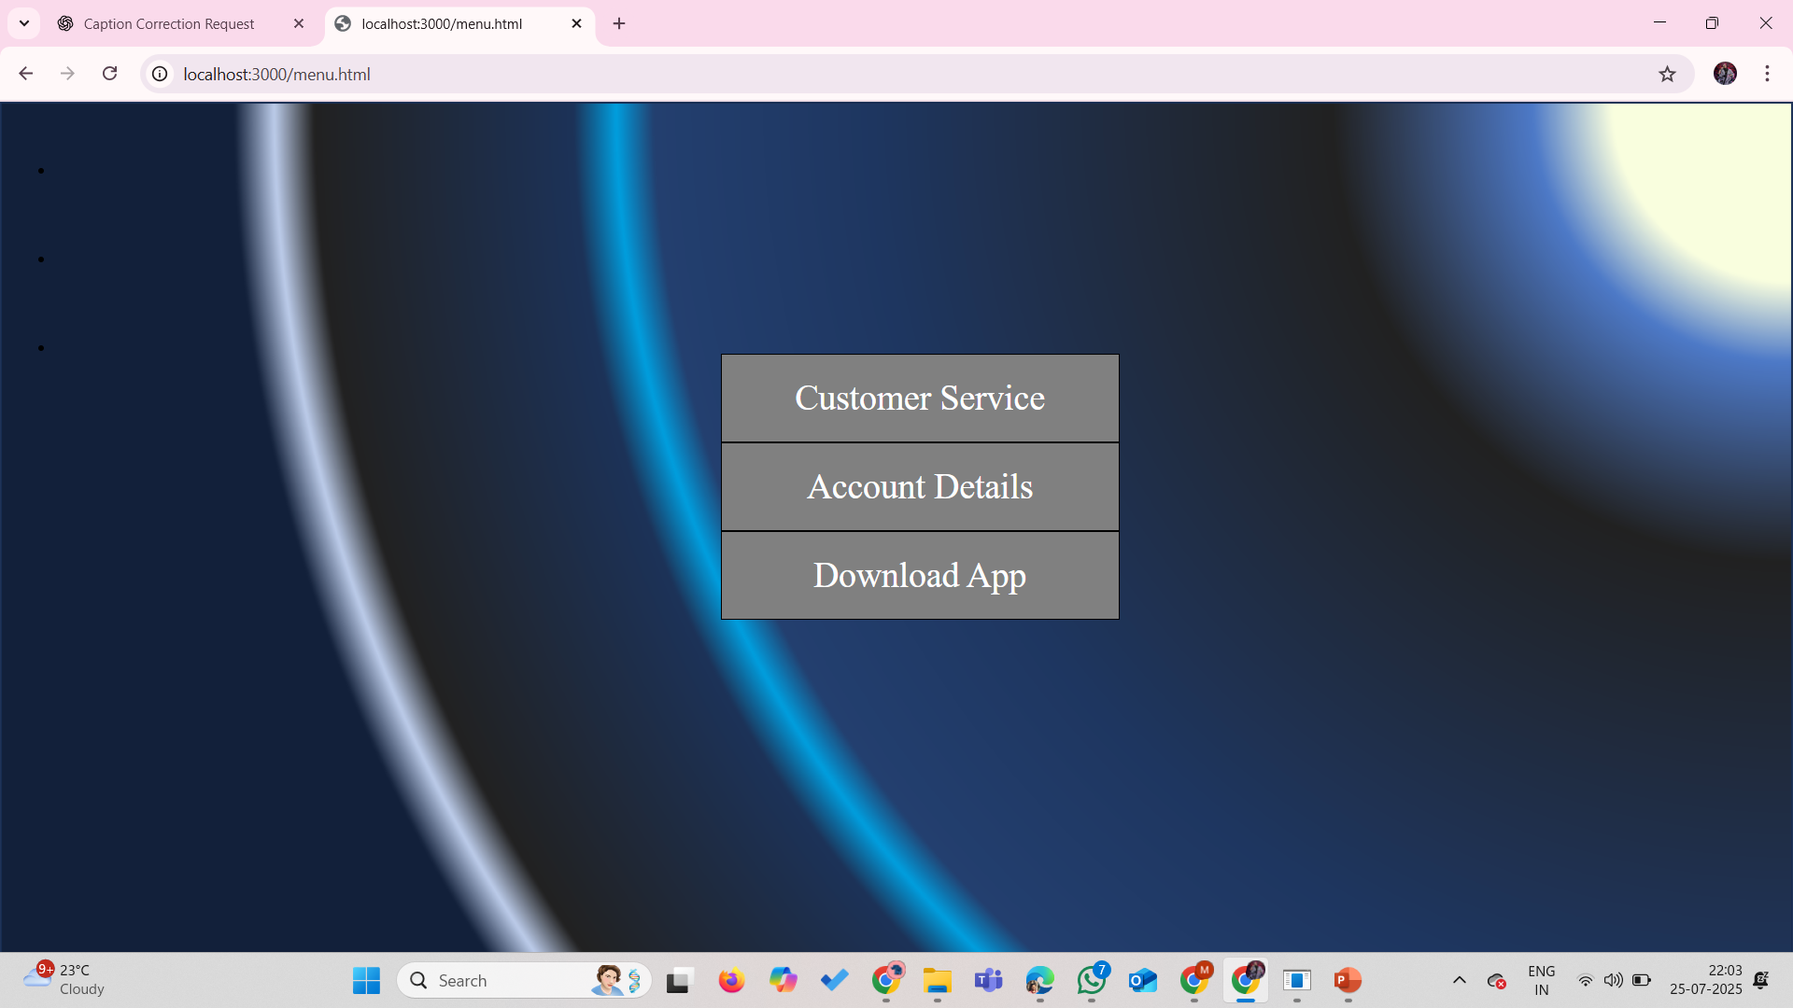
On tapping any of this icons or….

Slide 24
…or this options (except top)…next window will appear.

Slide 25
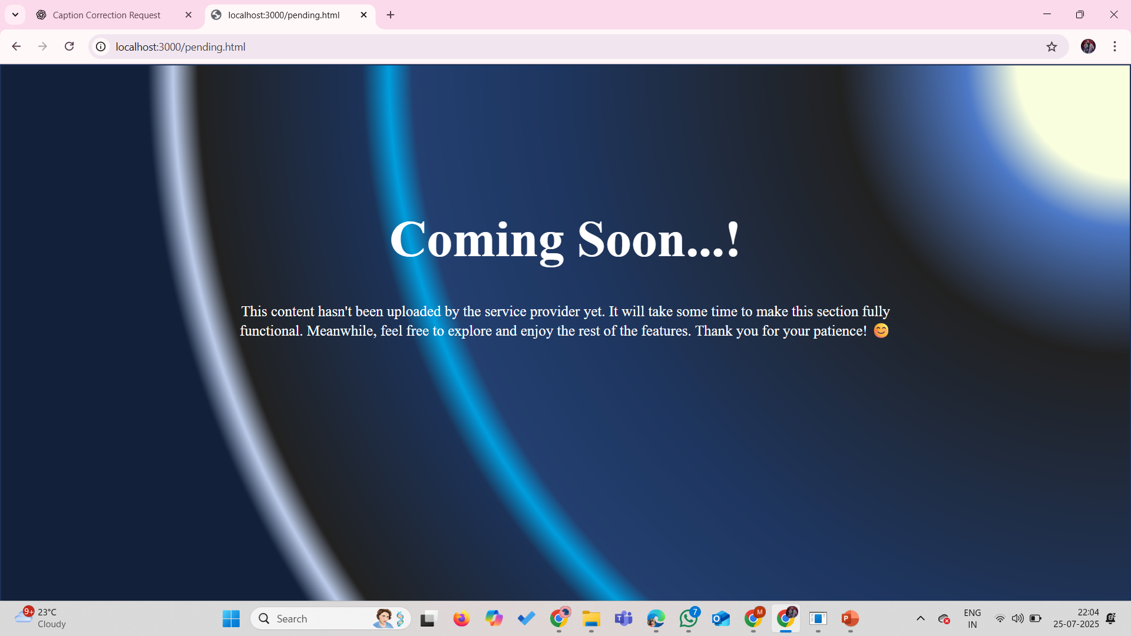
Since these options are not added yet.

